Slide 1
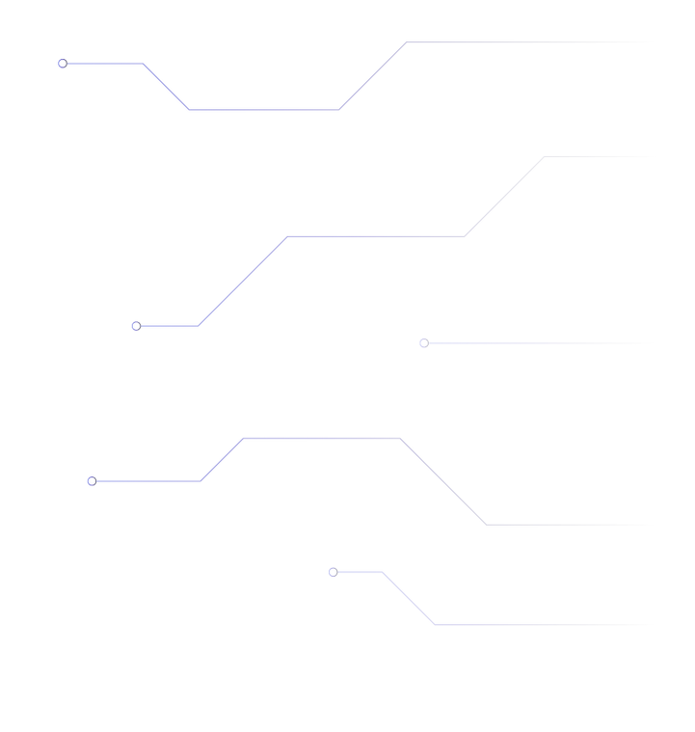
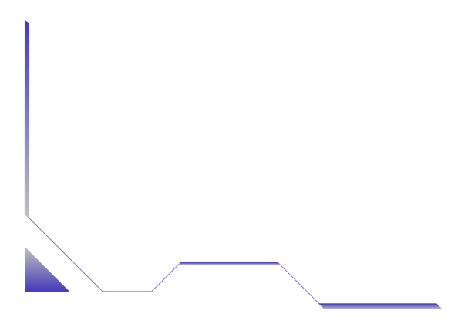
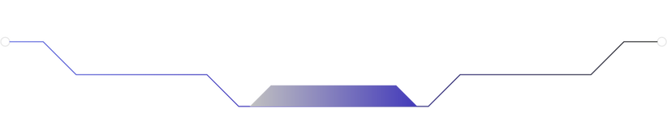


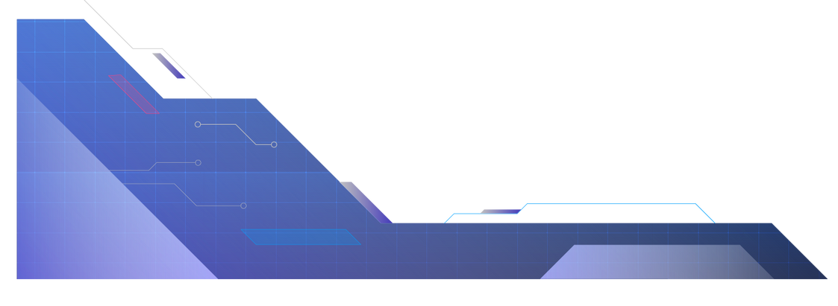
Flood-fill algorithm in a maze solving robot
Made by: Juan Diego Cabrera Moncada

Slide 2

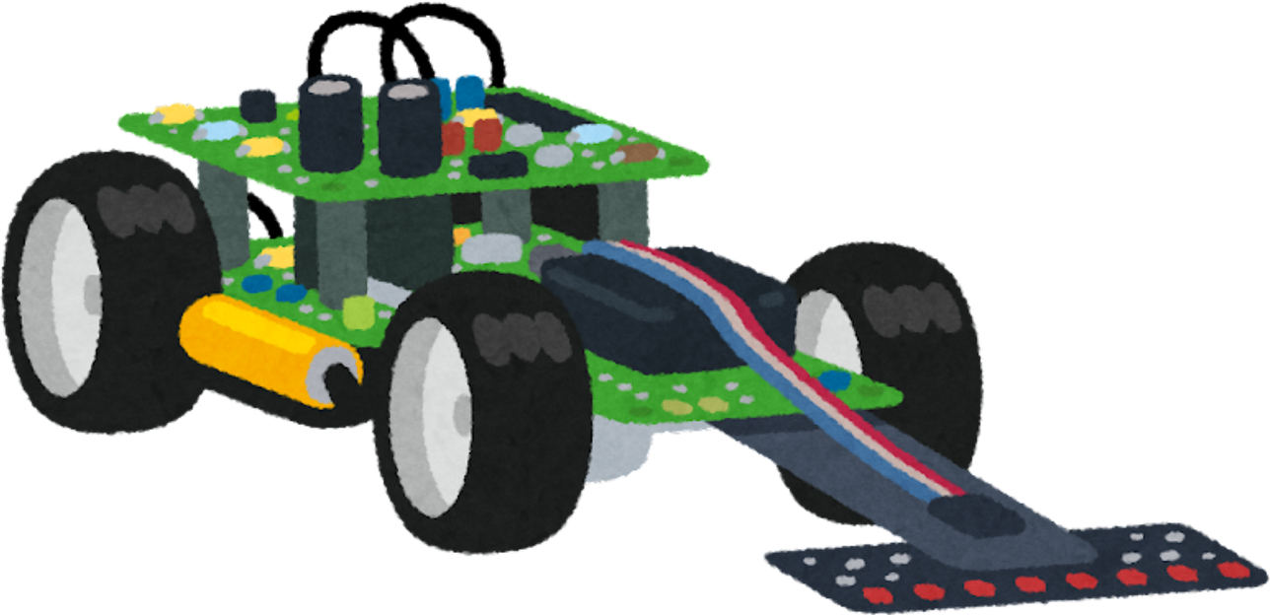

Introduction
Cuchau
Robot
Juan Diego
Cabrera Moncada
Student
Department of Electronic and Telecommunications Engineering

Slide 3
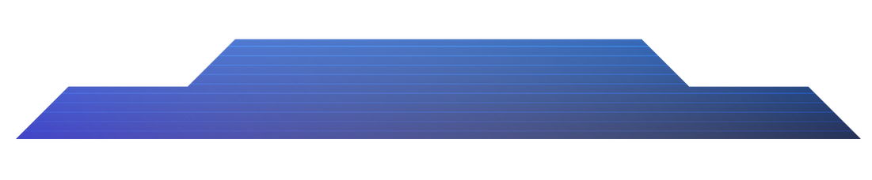





Motivation
Shortest Path Algorithm Research
Efficiency
Maze solving as an application problem
Short time solving mazes
Recursiveness
Autonomous navigation
Feedback analysis
Sensor data management
Decision making on path to take
Adjustments on robot’s pathing based on known data and new info

Slide 4

Problem statement
Representation of initial data
Sensor usage
Flood - fill algorithm implementation (Feedback info.)
Pathing decision making
Hardware configuration

Slide 5

Materials
ACTUATORS | 4 DC motors, each with one wheel connected.
SENSORS | 3 ultrasonic sensors (HC-SR04)
MECHANICAL STRUCTURE | Chasis of the robot and terminal block shield
POWER SOURCE | 9v battery and 3 rechargable batteries of 3.7v
MICROCONTROLLER | Arduino Nano
DRIVER | L298N module controlled via digital signals and PWM

Slide 6
Methods
01
02
Data initialization
Physical Model Construction
Maze 2D representation
Robot’s position and target
Sensors data parametrization
Pin assignment
Motor speed initialization
Structure of the robot
Location of sensors and actuators
03
04
Modules for data acquisition
Modules for robot’s control
Enabling sensors readings
Data updating based on sensors
Flood - fill algorithm
Rotation and movement of the robot
Robot’s position update and goal checking

Slide 7
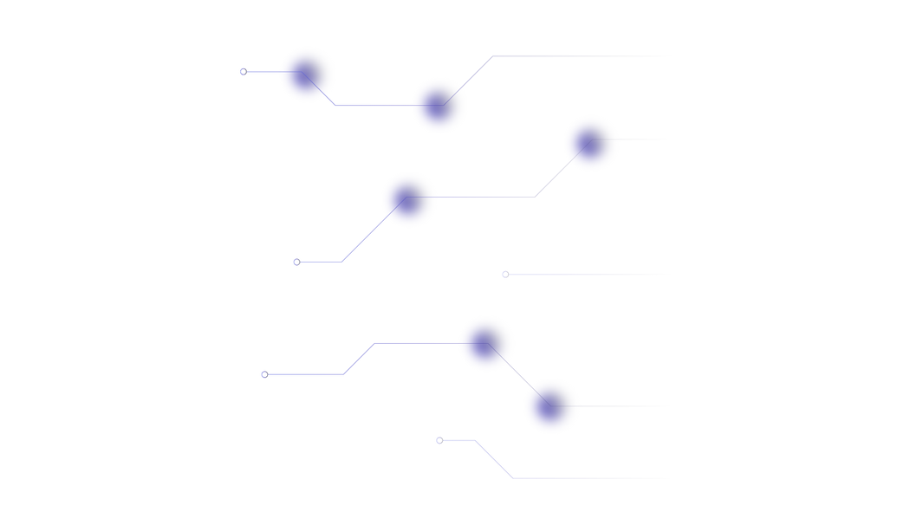
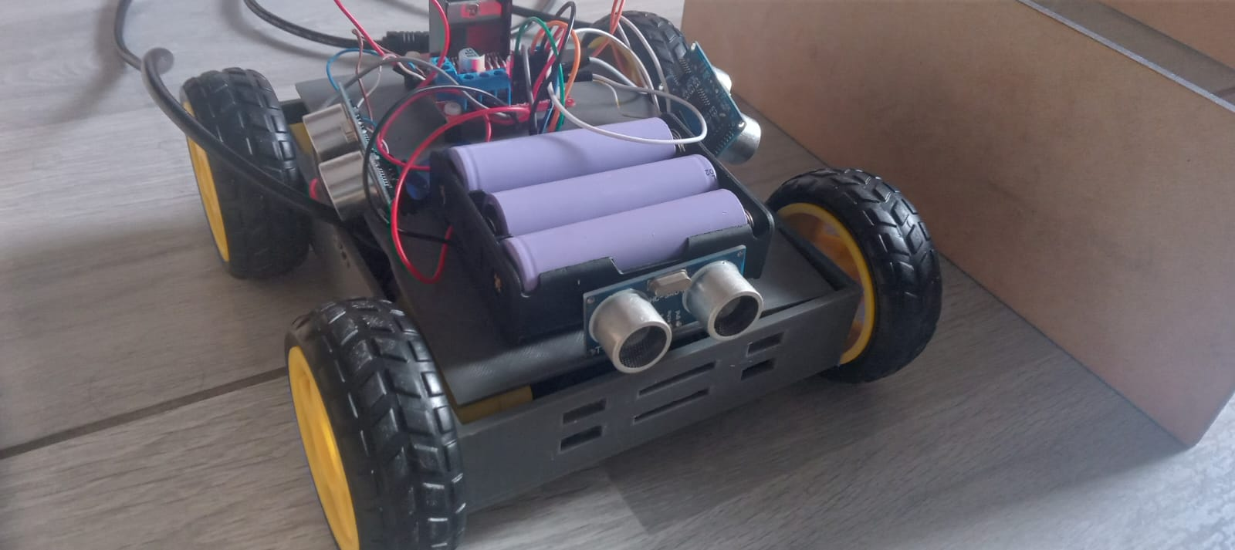
Results and Discussion

Slide 8
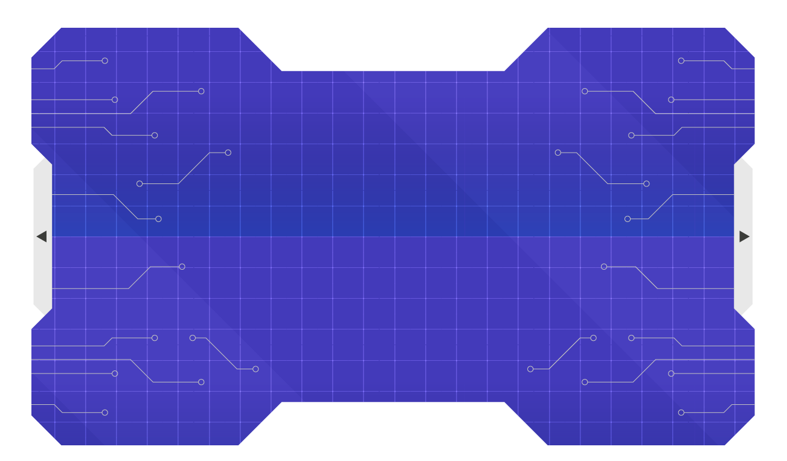
Videos
With no adjustments: https://youtu.be/sXtZGCfCFsg
With adjustments: https://youtu.be/ZhKnzUS-r1I

Slide 9
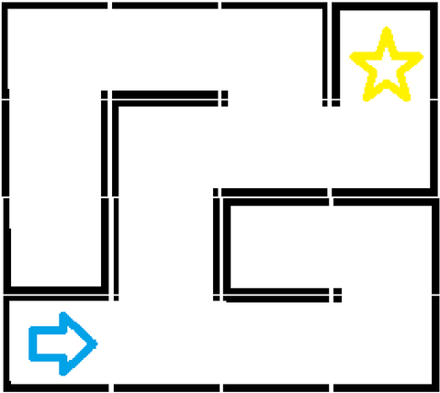
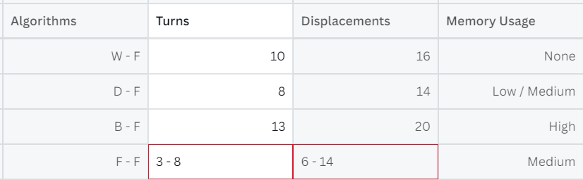
Results
Comparison with algorithms: Wall following, depth first search, breadth first search.
Hardware difficulties
Discussion
Efficiency as an algorithm
Simplicity in hardware
Environment conditions
Methods for callibration

Slide 10
Conclusions
Motors’ speed callibration, adjustments via coding, dust and floor conditions obstructs both the effectiveness of the robot’s repositioning and the time computation of the algorithm.
In comparison with other algorithms to find the shortest path to solve a maze, this algorithm guarantees us to find it efficiently via feedback control implementation based on sensors’ data given and storaged in the 2D representation of the maze.
The usage of an Arduino Nano allows us to reduce the size of the robot in future related implementations and also gives the opportunity to include more sensors and modules to ensure a better control of the robot’s repositioning and increase its efficiency.

Slide 11



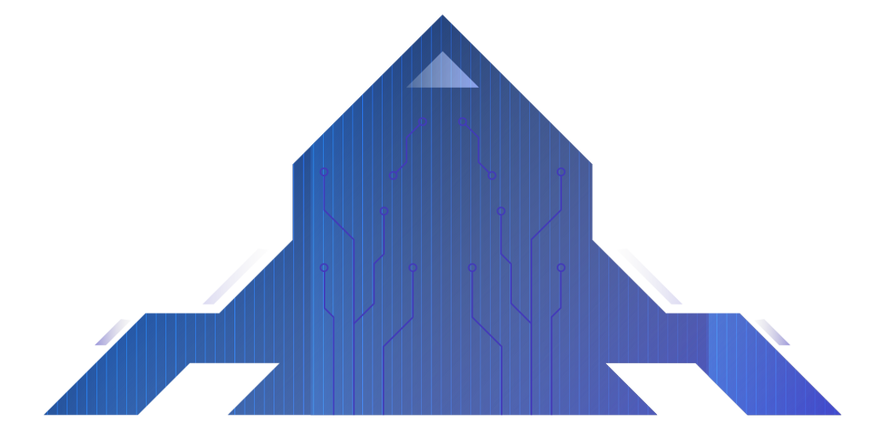
Future Work
Hardware additions
Best path for a maze
Robot reconstruction
4 ultrasonic sensors
1 MPU 6050
Finding the maze fastest / shortest path
IR sensors as replacements
Robot resizing
Reading diagonals
Proppelers implementation

Slide 12
THANKS!

Slide 13









































ICON PACK

